Slide 1
Smart Wear on Your Route
Huỳnh Quang Thảo – SE60963 – Team Leader
Trần Thanh Ngoan – SE
Nguyễn Trung Nam – SE
Ngô Tiến Đạt – SE
Supervisor:
Mr. Kiều Trọng Khánh

Slide 2
Overview
Problems
Solution
Feature explanation and demo
Search motorbike four points
Tracking motorbike’s route and notify
View notification on wear
Detect wrong route and recommend another route.
Search bus four points by using voice
Future plan
Notes:
Nhóm chúng tôi xin trình bày các nội dung sau:
Thứ nhất là vấn đề hiện tại của bảo hiểm xe máy
Thứ hai là giải pháp nhóm chúng tôi đưa ra
Tiếp đến là phần giải thích các chức năng và demo
Và cuối cùng là kế hoạch phát triển trong tương lai.
Sau đây anh Nguyễn Hữu Phúc sẽ trình bày về các vấn đề hiện tại của bảo hiểm xe máy

Slide 3


Slide 4


Problem 1: Missing routing assist mobile application
1

Slide 5

Problem 1: Missing routing assist mobile application
1

Slide 6

Problem 1: Missing routing assist mobile application
1

Slide 7

Problem 1: Missing routing assist mobile application
1

Slide 8

Problem 1: Missing routing assist mobile application
1

Slide 9
Problem 1: Missing routing assist mobile application
1

Slide 10
Problem 1: Missing routing assist mobile application
1

Slide 11
Problem 1: Missing routing assist mobile application
1

Slide 12
Problem 1: Missing routing assist mobile application
1

Slide 13

Problem 2: Supporting wear device
1
2

Slide 14
Problem 2: Supporting wear device
1
2

Slide 15
Problem 2: Supporting wear device
1
2

Slide 16
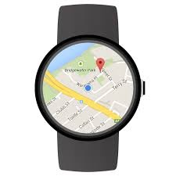
Problem 2: Supporting wear device
1
2

Slide 17

Problem 3: voice integration
1
2
3

Slide 18

Our team provides solutions to fix 3 above problems.

Slide 19
Providing a routing assist mobile application
Supporting search bus route and motorbike route from two points to four points.
Supporting routing by message at every bus station or motorbike turn.
Wrong-way detection system.
Supporting map offline.

Slide 20

Providing a routing assist mobile application

Slide 21
Providing wear application and can display search result.
Display search result on wear’s google map.
At every bus station customer should leave or at each motorbike’s turn, application will notify a message or vibrate device.

Slide 22
Providing voice search command and sound result.
Customer can search by using voice command.
Providing sound alert at each bus station or motorbike turn.

Slide 23


2. Solution
SWR System
Centre management application
Android Application
Mobile application
Web application
Web application
Wear Application
Notes:
1 ứng dụng giả lập thiết bị đọc thẻ chạy trên «smart phone» dành cho CSGT để kiểm tra thông tin bảo hiểm cũng như có thể thêm thông tin vi phạm của khách hàng.

Slide 24
Parse bus route
How to parse bus route and build entities

Slide 25
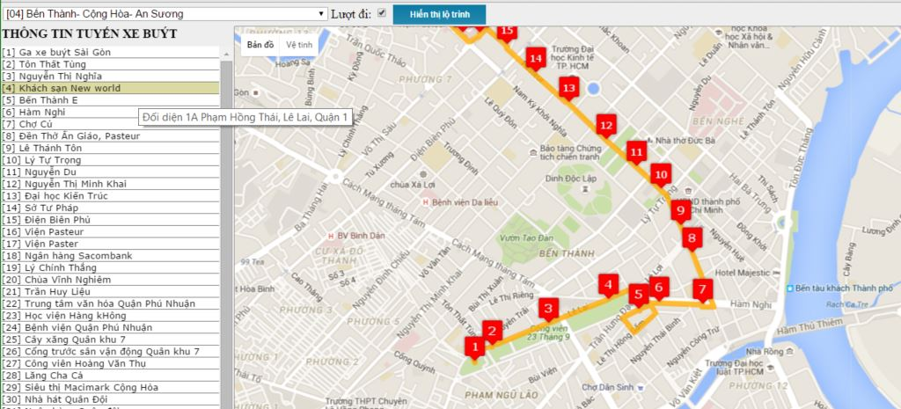
BUSES ROUTE INFORMATION
http://route.buyttphcm.com.vn/routeoftrunk.aspx

Slide 26
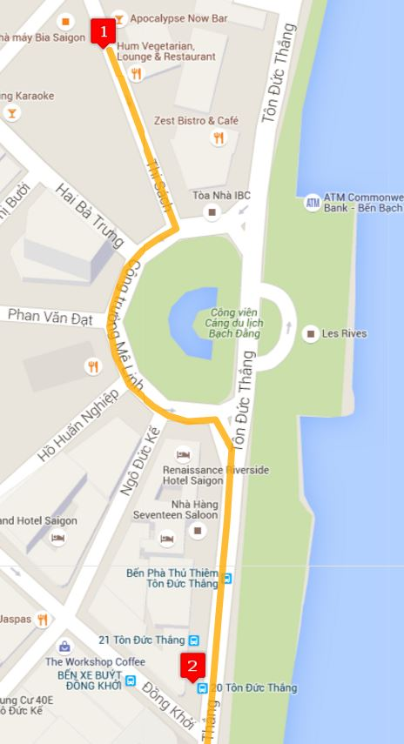
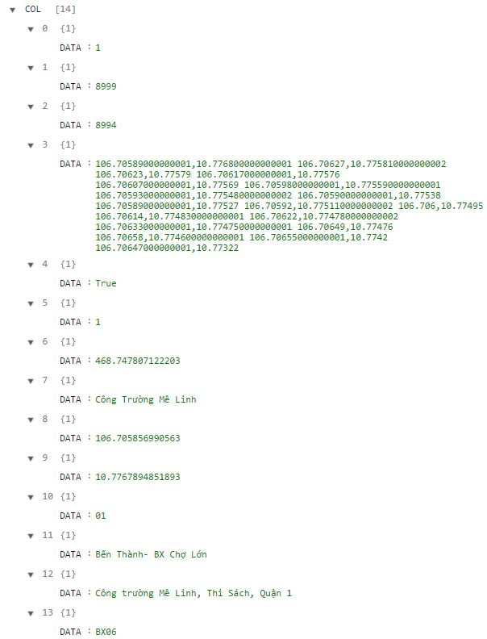
http://mapbus.ebms.vn/ajax.aspx?action=listRouteStations&rid=1&isgo=true

Slide 27
Index | Sample value | Attribute
0 | 1 | Route’s id
1 | 8999 | Stop station’s ID
2 | 8994 | Stop station’s ID
3 | 106.70589000000001,10.776800000000001 | Middle points
4 | True | Turn (isgo parameter)
5 | 1 | Order in route
6 | 468.747807122203 | Distance
7 | Công Trường Mê Linh | Start station’s name
8 | 106.705856990563 | Start station’s longitude
9 | 10.7767894851893 | Start station’s latitude
10 | 01 | Bus number
11 | Bến Thành- BX Chợ Lớn | Bus name
12 | Công trường Mê Linh, Thi Sách, Quận 1 | Start station’s address
13 | BX06 | Start station’s code
http://mapbus.ebms.vn/ajax.aspx?action=listRouteStations&rid=1&isgo=true

Slide 28
ROUTE

Slide 29
Index | Sample value
0 | 1
1 | 8999
2 | 8994
3 | 106.70589000000001,10.776800000000001 106.70627,10.775810000000002 106.70623,10.77579 106.70617000000001,10.77576 ...
4 | True
5 | 1
6 | 468.747807122203
7 | Công Trường Mê Linh
8 | 106.705856990563
9 | 10.7767894851893
10 | 01
11 | Bến Thành- BX Chợ Lớn
12 | Công trường Mê Linh, Thi Sách, Quận 1
13 | BX06
Route
RouteType
http://mapbus.ebms.vn/ajax.aspx?action=listRouteStations&rid=1&isgo=true

Slide 30
Index | Sample value
0 | 1
1 | 8999
2 | 8994
3 | 106.70589000000001,10.776800000000001 106.70627,10.775810000000002 106.70623,10.77579 106.70617000000001,10.77576 ...
4 | True
5 | 1
6 | 468.747807122203
7 | Công Trường Mê Linh
8 | 106.705856990563
9 | 10.7767894851893
10 | 01
11 | Bến Thành- BX Chợ Lớn
12 | Công trường Mê Linh, Thi Sách, Quận 1
13 | BX06
Route
RouteType
RouteNo
http://mapbus.ebms.vn/ajax.aspx?action=listRouteStations&rid=1&isgo=true

Slide 31
Index | Sample value
0 | 1
1 | 8999
2 | 8994
3 | 106.70589000000001,10.776800000000001 106.70627,10.775810000000002 106.70623,10.77579 106.70617000000001,10.77576 ...
4 | True
5 | 1
6 | 468.747807122203
7 | Công Trường Mê Linh
8 | 106.705856990563
9 | 10.7767894851893
10 | 01
11 | Bến Thành- BX Chợ Lớn
12 | Công trường Mê Linh, Thi Sách, Quận 1
13 | BX06
Route
RouteType
RouteNo
RouteName
http://mapbus.ebms.vn/ajax.aspx?action=listRouteStations&rid=1&isgo=true

Slide 32
STATION

Slide 33
Index | Sample value
0 | 1
1 | 8999
2 | 8994
3 | 106.70589000000001,10.776800000000001 106.70627,10.775810000000002 106.70623,10.77579 106.70617000000001,10.77576 ...
4 | True
5 | 1
6 | 468.747807122203
7 | Công Trường Mê Linh
8 | 106.705856990563
9 | 10.7767894851893
10 | 01
11 | Bến Thành- BX Chợ Lớn
12 | Công trường Mê Linh, Thi Sách, Quận 1
13 | BX06
Station
CodeID
http://mapbus.ebms.vn/ajax.aspx?action=listRouteStations&rid=1&isgo=true

Slide 34
Index | Sample value
0 | 1
1 | 8999
2 | 8994
3 | 106.70589000000001,10.776800000000001 106.70627,10.775810000000002 106.70623,10.77579 106.70617000000001,10.77576 ...
4 | True
5 | 1
6 | 468.747807122203
7 | Công Trường Mê Linh
8 | 106.705856990563
9 | 10.7767894851893
10 | 01
11 | Bến Thành- BX Chợ Lớn
12 | Công trường Mê Linh, Thi Sách, Quận 1
13 | BX06
Station
CodeID
Street
http://mapbus.ebms.vn/ajax.aspx?action=listRouteStations&rid=1&isgo=true

Slide 35
Index | Sample value
0 | 1
1 | 8999
2 | 8994
3 | 106.70589000000001,10.776800000000001 106.70627,10.775810000000002 106.70623,10.77579 106.70617000000001,10.77576 ...
4 | True
5 | 1
6 | 468.747807122203
7 | Công Trường Mê Linh
8 | 106.705856990563
9 | 10.7767894851893
10 | 01
11 | Bến Thành- BX Chợ Lớn
12 | Công trường Mê Linh, Thi Sách, Quận 1
13 | BX06
Station
CodeID
Street
Latitude
http://mapbus.ebms.vn/ajax.aspx?action=listRouteStations&rid=1&isgo=true

Slide 36
Index | Sample value
0 | 1
1 | 8999
2 | 8994
3 | 106.70589000000001,10.776800000000001 106.70627,10.775810000000002 106.70623,10.77579 106.70617000000001,10.77576 ...
4 | True
5 | 1
6 | 468.747807122203
7 | Công Trường Mê Linh
8 | 106.705856990563
9 | 10.7767894851893
10 | 01
11 | Bến Thành- BX Chợ Lớn
12 | Công trường Mê Linh, Thi Sách, Quận 1
13 | BX06
Station
CodeID
Street
Latitude
Longitude
http://mapbus.ebms.vn/ajax.aspx?action=listRouteStations&rid=1&isgo=true

Slide 37
Index | Sample value
0 | 1
1 | 8999
2 | 8994
3 | 106.70589000000001,10.776800000000001 106.70627,10.775810000000002 106.70623,10.77579 106.70617000000001,10.77576 ...
4 | True
5 | 1
6 | 468.747807122203
7 | Công Trường Mê Linh
8 | 106.705856990563
9 | 10.7767894851893
10 | 01
11 | Bến Thành- BX Chợ Lớn
12 | Công trường Mê Linh, Thi Sách, Quận 1
13 | BX06
Station
CodeID
Street
Latitude
Longitude
Name
http://mapbus.ebms.vn/ajax.aspx?action=listRouteStations&rid=1&isgo=true

Slide 38
PATHINFO

Slide 40
Index | Sample value
0 | 1
1 | 8999
2 | 8994
3 | 106.70589000000001,10.776800000000001 106.70627,10.775810000000002 106.70623,10.77579 106.70617000000001,10.77576 ...
4 | True
5 | 1
6 | 468.747807122203
7 | Công Trường Mê Linh
8 | 106.705856990563
9 | 10.7767894851893
10 | 01
11 | Bến Thành- BX Chợ Lớn
12 | Công trường Mê Linh, Thi Sách, Quận 1
13 | BX06
PathInfo
PathInfoNo
http://mapbus.ebms.vn/ajax.aspx?action=listRouteStations&rid=1&isgo=true

Slide 41
Index | Sample value
0 | 1
1 | 8999
2 | 8994
3 | 106.70589000000001,10.776800000000001 106.70627,10.775810000000002 106.70623,10.77579 106.70617000000001,10.77576 ...
4 | True
5 | 1
6 | 468.747807122203
7 | Công Trường Mê Linh
8 | 106.705856990563
9 | 10.7767894851893
10 | 01
11 | Bến Thành- BX Chợ Lớn
12 | Công trường Mê Linh, Thi Sách, Quận 1
13 | BX06
PathInfo
PahtInfoNo
MiddlePoints
http://mapbus.ebms.vn/ajax.aspx?action=listRouteStations&rid=1&isgo=true

Slide 42
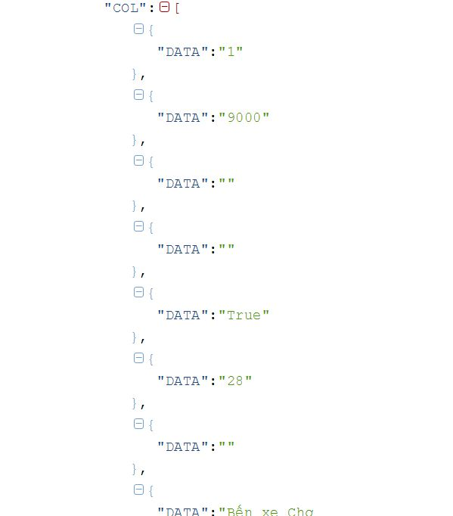
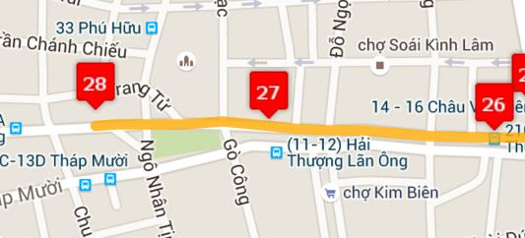

Slide 43
Station
CodeID
Street
Latitude
Longitude
Name
PathInfo
FromStationID
ToStationID
RouteID
PahtInfoNo
MiddlePoints
Route
RouteType
RouteNo
RouteName
$$∞$$
start
1
1
includes
$$∞$$
$$∞$$
stop
0..1

Slide 44
TRIP

Slide 45
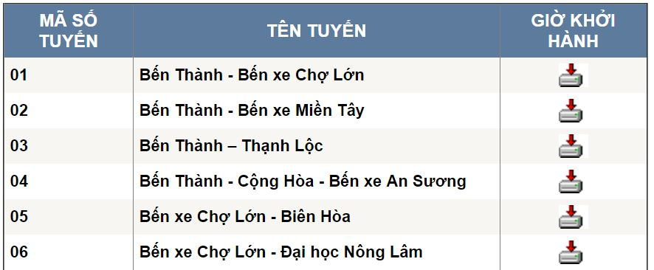
BUSES TRIP INFORMATION
http://buyttphcm.com.vn/TTLT.aspx

Slide 46
Route
RouteType
RouteNo
RouteName
http://buyttphcm.com.vn/TTLT.aspx

Slide 47
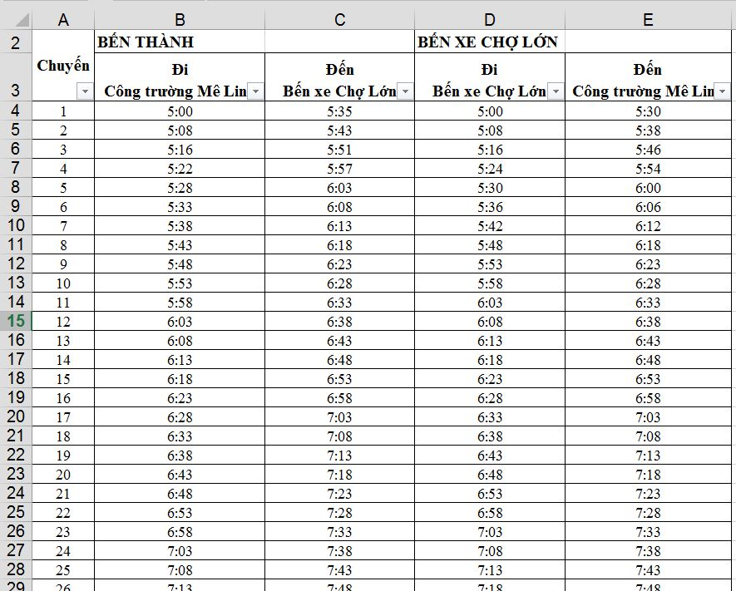
Time of route depart
Time of route return

Slide 48
Route
RouteType
RouteNo
RouteName
1
includes
$$∞$$
Trip
RouteID
Time of route depart
Time of route return

Slide 49
Time of route depart
Time of route return
Trip
RouteID
TripNo

Slide 50
Time of route depart
Time of route return
Trip
RouteID
TripNo
StartTime

Slide 51
Time of route depart
Time of route return
Trip
RouteID
TripNo
StartTime
EndTime

Slide 52
Station
CodeID
Street
Latitude
Longitude
Name
PathInfo
FromStationID
ToStationID
RouteID
MiddlePoints
PathInfoNo
Route
RouteType
RouteNo
RouteName
$$∞$$
start
1
1
includes
$$∞$$
$$∞$$
stop
1
1
includes
$$∞$$
Trip
RouteID
TripNo
StartTime
EndTime

Slide 53
Raptor algorithm
Algorithm for searching shortest route between two point

Slide 55

S
T

Slide 56
S
20m
T

Slide 57
S
20m
5m
T

Slide 58
S
20m
5m
15m
T

Slide 59
S
20m
5m
15m
20m
T

Slide 60
S
20m
5m
15m
20m
T
15m

Slide 61
S
20m
5m
15m
20m
T
15m
5m

Slide 62
Turn | Station | 1 | 2 | 3 | 4 | 5 | 6
K = 1 | Arrivial Time | MAX | MAX | MAX | MAX | MAX | MAX
Optimize Station:
24
55
4
6
18
5
27
1
3
2

Slide 63
Turn | Station | 1 | 2 | 3 | 4 | 5 | 6
K = 1 | Arrivial Time | 8:00 | MAX | MAX | MAX | MAX | MAX
Optimize Station: (1)
24
55
4
6
18
5
27
1
3
2

Slide 64
Turn | Station | 1 | 2 | 3 | 4 | 5 | 6
K = 1 | Arrivial Time | 8:00 | MAX | MAX | MAX | MAX | MAX
Optimize Station: ()
24
55
4
6
18
5
8:20
27
1
8:25
8:10
3
8:05
2
8:15
8:30

Slide 65
Turn | Station | 1 | 2 | 3 | 4 | 5 | 6
K = 1 | Arrivial Time | 8:00 | 8:10 | 8:25 | MAX | MAX | MAX
Optimize Station: () (2,3)
24
55
4
6
18
5
8:20
27
1
8:25
8:10
3
8:05
2
8:15
8:30

Slide 66
Turn | Station | 1 | 2 | 3 | 4 | 5 | 6
K = 1 | Arrivial Time | 8:00 | 8:10 | 8:25 | MAX | MAX | MAX
Optimize Station: (2)
24
55
4
6
18
5
8:20
27
1
8:25
8:10
3
2
8:15
8:30

Slide 67
Turn | Station | 1 | 2 | 3 | 4 | 5 | 6
K = 1 | Arrivial Time | 8:00 | 8:10 | 8:25 | MAX | MAX | MAX
Optimize Station: (2)
24
55
4
6
18
5
8:20
27
1
8:25
3
2
8:15
8:30

Slide 68
Turn | Station | 1 | 2 | 3 | 4 | 5 | 6
K = 1 | Arrivial Time | 8:00 | 8:10 | MAX | MAX | MAX | MAX
Optimize Station: (2)
24
55
4
6
18
5
8:20
27
1
8:25
3
2
8:30

Slide 69
Turn | Station | 1 | 2 | 3 | 4 | 5 | 6
K = 1 | Arrivial Time | 8:00 | 8:10 | 8:20 | MAX | MAX | MAX
Optimize Station: (2, 3)
24
55
4
6
18
5
27
1
8:25
3
2
8:30

Slide 70
Turn | Station | 1 | 2 | 3 | 4 | 5 | 6
K = 1 | Arrivial Time | 8:00 | 8:10 | 8:20 | MAX | MAX | MAX
Optimize Station: (2, 3)
24
55
4
6
18
5
27
1
3
2
8:30

Slide 71
Turn | Station | 1 | 2 | 3 | 4 | 5 | 6
K = 1 | Arrivial Time | 8:00 | 8:10 | 8:20 | MAX | MAX | MAX
K = 2 | Arrival Time | 8:00 | 8:10 | 8:20 | MAX | MAX | MAX
Optimize Station: (2, 3)
24
55
4
6
18
5
55
27
1
3
2

Slide 72
Turn | Station | 1 | 2 | 3 | 4 | 5 | 6
K = 1 | Arrivial Time | 8:00 | 8:10 | 8:20 | MAX | MAX | MAX
K = 2 | Arrival Time | 8:00 | 8:10 | 8:20 | MAX | MAX | MAX
Optimize Station: (2, 3)
24
55
8:23
4
8:20
6
18
5
8:19
55
8:17
27
1
3
2
8:15

Slide 73
Turn | Station | 1 | 2 | 3 | 4 | 5 | 6
K = 1 | Arrivial Time | 8:00 | 8:10 | 8:20 | MAX | MAX | MAX
K = 2 | Arrival Time | 8:00 | 8:10 | 8:20 | 8:20 | MAX | MAX
Optimize Station: (3) (4)
24
55
8:23
4
8:20
6
18
5
8:19
8:17
27
1
3
2
8:15

Slide 74
Turn | Station | 1 | 2 | 3 | 4 | 5 | 6
K = 1 | Arrivial Time | 8:00 | 8:10 | 8:20 | MAX | MAX | MAX
K = 2 | Arrival Time | 8:00 | 8:10 | 8:20 | 8:20 | MAX | MAX
Optimize Station: (3) (4)
24
55
8:23
4
8:20
6
18
5
8:19
8:17
27
1
3
2

Slide 75
Turn | Station | 1 | 2 | 3 | 4 | 5 | 6
K = 1 | Arrivial Time | 8:00 | 8:10 | 8:20 | MAX | MAX | MAX
K = 2 | Arrival Time | 8:00 | 8:10 | 8:20 | 8:20 | MAX | MAX
Optimize Station: (3) (4)
24
55
8:23
4
8:20
6
18
5
8:19
27
1
3
2

Slide 76
Turn | Station | 1 | 2 | 3 | 4 | 5 | 6
K = 1 | Arrivial Time | 8:00 | 8:10 | 8:20 | MAX | MAX | MAX
K = 2 | Arrival Time | 8:00 | 8:10 | 8:20 | 8:20 | MAX | MAX
Optimize Station: (3) (4)
24
55
8:23
4
8:20
6
18
5
27
1
3
2

Slide 77
Turn | Station | 1 | 2 | 3 | 4 | 5 | 6
K = 1 | Arrivial Time | 8:00 | 8:10 | 8:20 | MAX | MAX | MAX
K = 2 | Arrival Time | 8:00 | 8:10 | 8:20 | 8:20 | MAX | MAX
Optimize Station: (3) (4)
24
55
8:23
4
6
18
5
27
1
3
2

Slide 78
Turn | Station | 1 | 2 | 3 | 4 | 5 | 6
K = 1 | Arrivial Time | 8:00 | 8:10 | 8:20 | MAX | MAX | MAX
K = 2 | Arrival Time | 8:00 | 8:10 | 8:20 | 8:20 | MAX | MAX
Optimize Station: (3) (4)
24
55
4
6
18
5
27
1
3
2

Slide 79
Turn | Station | 1 | 2 | 3 | 4 | 5 | 6
K = 1 | Arrivial Time | 8:00 | 8:10 | 8:20 | MAX | MAX | MAX
K = 2 | Arrival Time | 8:00 | 8:10 | 8:20 | 8:20 | MAX | MAX
Optimize Station: () (4)
24
55
8:27
4
8:25
6
18
5
8:23
8:22
27
1
3
8:21
2

Slide 80
Turn | Station | 1 | 2 | 3 | 4 | 5 | 6
K = 1 | Arrivial Time | 8:00 | 8:10 | 8:20 | MAX | MAX | MAX
K = 2 | Arrival Time | 8:00 | 8:10 | 8:20 | 8:20 | 8:25 | MAX
Optimize Station: () (4,5)
24
55
8:27
4
8:25
6
18
5
8:23
8:22
27
1
3
8:21
2

Slide 81
Turn | Station | 1 | 2 | 3 | 4 | 5 | 6
K = 1 | Arrivial Time | 8:00 | 8:10 | 8:20 | MAX | MAX | MAX
K = 2 | Arrival Time | 8:00 | 8:10 | 8:20 | 8:20 | 8:25 | MAX
Optimize Station: () (4,5)
24
55
8:27
4
8:25
6
18
5
8:23
8:22
27
1
3
2

Slide 82
Turn | Station | 1 | 2 | 3 | 4 | 5 | 6
K = 1 | Arrivial Time | 8:00 | 8:10 | 8:20 | MAX | MAX | MAX
K = 2 | Arrival Time | 8:00 | 8:10 | 8:20 | 8:20 | 8:25 | MAX
Optimize Station: () (4,5)
24
55
8:27
4
8:25
6
18
5
8:23
27
1
3
2

Slide 83
Turn | Station | 1 | 2 | 3 | 4 | 5 | 6
K = 1 | Arrivial Time | 8:00 | 8:10 | 8:20 | MAX | MAX | MAX
K = 2 | Arrival Time | 8:00 | 8:10 | 8:20 | 8:20 | 8:25 | MAX
Optimize Station: () (4,5)
24
55
8:27
4
8:25
6
18
5
27
1
3
2

Slide 84
Turn | Station | 1 | 2 | 3 | 4 | 5 | 6
K = 1 | Arrivial Time | 8:00 | 8:10 | 8:20 | MAX | MAX | MAX
K = 2 | Arrival Time | 8:00 | 8:10 | 8:20 | 8:20 | 8:25 | MAX
Optimize Station: () (4,5)
24
55
8:27
4
6
18
5
27
1
3
2

Slide 85
Turn | Station | 1 | 2 | 3 | 4 | 5 | 6
K = 2 | Arrivial Time | 8:00 | 8:10 | 8:20 | 8:20 | 8:25 | MAX
K = 3 | Arrival Time | 8:00 | 8:10 | 8:20 | 8:20 | 8:25 | MAX
Optimize Station: () (4,5)
24
55
4
6
18
5
27
1
3
2

Slide 86
Turn | Station | 1 | 2 | 3 | 4 | 5 | 6
K = 2 | Arrivial Time | 8:00 | 8:10 | 8:20 | 8:20 | 8:25 | MAX
K = 3 | Arrival Time | 8:00 | 8:10 | 8:20 | 8:20 | 8:25 | MAX
Optimize Station: () (4,5)
24
55
4
6
18
5
27
1
3
2

Slide 87
Turn | Station | 1 | 2 | 3 | 4 | 5 | 6
K = 2 | Arrivial Time | 8:00 | 8:10 | 8:20 | 8:20 | 8:25 | MAX
K = 3 | Arrival Time | 8:00 | 8:10 | 8:20 | 8:20 | 8:25 | MAX
Optimize Station: () (4)
24
55
4
6
18
5
27
1
3
2

Slide 88
Turn | Station | 1 | 2 | 3 | 4 | 5 | 6
K = 2 | Arrivial Time | 8:00 | 8:10 | 8:20 | 8:20 | 8:25 | MAX
K = 3 | Arrival Time | 8:00 | 8:10 | 8:20 | 8:20 | 8:25 | MAX
Optimize Station: () (4)
24
55
4
6
18
5
27
1
3
2

Slide 89
Turn | Station | 1 | 2 | 3 | 4 | 5 | 6
K = 2 | Arrivial Time | 8:00 | 8:10 | 8:20 | 8:20 | 8:25 | MAX
K = 3 | Arrival Time | 8:00 | 8:10 | 8:20 | 8:20 | 8:25 | MAX
Optimize Station: () ()
24
55
8:27
8:30
8:22
6
18
4
5
8:24
8:27
8:26
27
1
3
2

Slide 90
Turn | Station | 1 | 2 | 3 | 4 | 5 | 6
K = 2 | Arrivial Time | 8:00 | 8:10 | 8:20 | 8:20 | 8:25 | MAX
K = 3 | Arrival Time | 8:00 | 8:10 | 8:20 | 8:20 | 8:25 | 8:30
Optimize Station: () (4)
24
55
8:27
8:30
8:22
6
18
4
5
8:24
8:27
8:26
27
1
3
2

Slide 91
Turn | Station | 1 | 2 | 3 | 4 | 5 | 6
K = 2 | Arrivial Time | 8:00 | 8:10 | 8:20 | 8:20 | 8:25 | MAX
K = 3 | Arrival Time | 8:00 | 8:10 | 8:20 | 8:20 | 8:25 | 8:30
Optimize Station: () (4)
24
55
8:27
8:30
4
6
18
5
8:24
8:27
8:26
27
1
3
2

Slide 92
Turn | Station | 1 | 2 | 3 | 4 | 5 | 6
K = 2 | Arrivial Time | 8:00 | 8:10 | 8:20 | 8:20 | 8:25 | MAX
K = 3 | Arrival Time | 8:00 | 8:10 | 8:20 | 8:20 | 8:25 | 8:30
Optimize Station: () (4)
24
55
8:27
8:30
4
6
18
5
8:27
8:26
27
1
3
2

Slide 93
Turn | Station | 1 | 2 | 3 | 4 | 5 | 6
K = 2 | Arrivial Time | 8:00 | 8:10 | 8:20 | 8:20 | 8:25 | MAX
K = 3 | Arrival Time | 8:00 | 8:10 | 8:20 | 8:20 | 8:25 | 8:30
Optimize Station: () (4)
24
55
8:27
8:28
4
6
18
5
8:26
27
1
3
2

Slide 94
Turn | Station | 1 | 2 | 3 | 4 | 5 | 6
K = 2 | Arrivial Time | 8:00 | 8:10 | 8:20 | 8:20 | 8:25 | MAX
K = 3 | Arrival Time | 8:00 | 8:10 | 8:20 | 8:20 | 8:25 | 8:30
Optimize Station: () (4)
24
55
8:27
8:28
4
6
18
5
8:26
27
1
3
2

Slide 95
Turn | Station | 1 | 2 | 3 | 4 | 5 | 6
K = 2 | Arrivial Time | 8:00 | 8:10 | 8:20 | 8:20 | 8:25 | MAX
K = 3 | Arrival Time | 8:00 | 8:10 | 8:20 | 8:20 | 8:25 | 8:28
Optimize Station: () (4)
24
55
8:27
8:28
4
6
18
5
8:26
27
1
3
2

Slide 96
Turn | Station | 1 | 2 | 3 | 4 | 5 | 6
K = 2 | Arrivial Time | 8:00 | 8:10 | 8:20 | 8:20 | 8:25 | MAX
K = 3 | Arrival Time | 8:00 | 8:10 | 8:20 | 8:20 | 8:25 | 8:28
Optimize Station: () (4)
24
55
8:27
8:28
4
6
18
5
27
1
3
2

Slide 97
Turn | Station | 1 | 2 | 3 | 4 | 5 | 6
K = 2 | Arrivial Time | 8:00 | 8:10 | 8:20 | 8:20 | 8:25 | MAX
K = 3 | Arrival Time | 8:00 | 8:10 | 8:20 | 8:20 | 8:25 | 8:28
Optimize Station:
24
55
8:27
8:28
4
6
18
5
27
1
3
2

Slide 98



Search Bus Route
Search Route
Search Motorbike Route

Slide 99
Search Bus Route
Search Route
Search Bus Route

Slide 100




Scenario
Ngoan
Nam
Quy
Thao

Slide 101
Scenario
Ngoan
Nam
Quy
Thao
Công Viên Tao Đàn
280 Nguyễn Đình Chiểu
VinCom Lê Thánh Tôn
Bến xe quận 8

Slide 102
Scenario
Ngoan
Nam
Quy
Thao
Công Viên Tao Đàn
280 Nguyễn Đình Chiểu
VinCom Lê Thánh Tôn
Bến xe quận 8
Sinh Nhật
Đám Cưới
Tân Gia

Slide 103

Scenario
Best Order ?
1
2
3

Slide 104
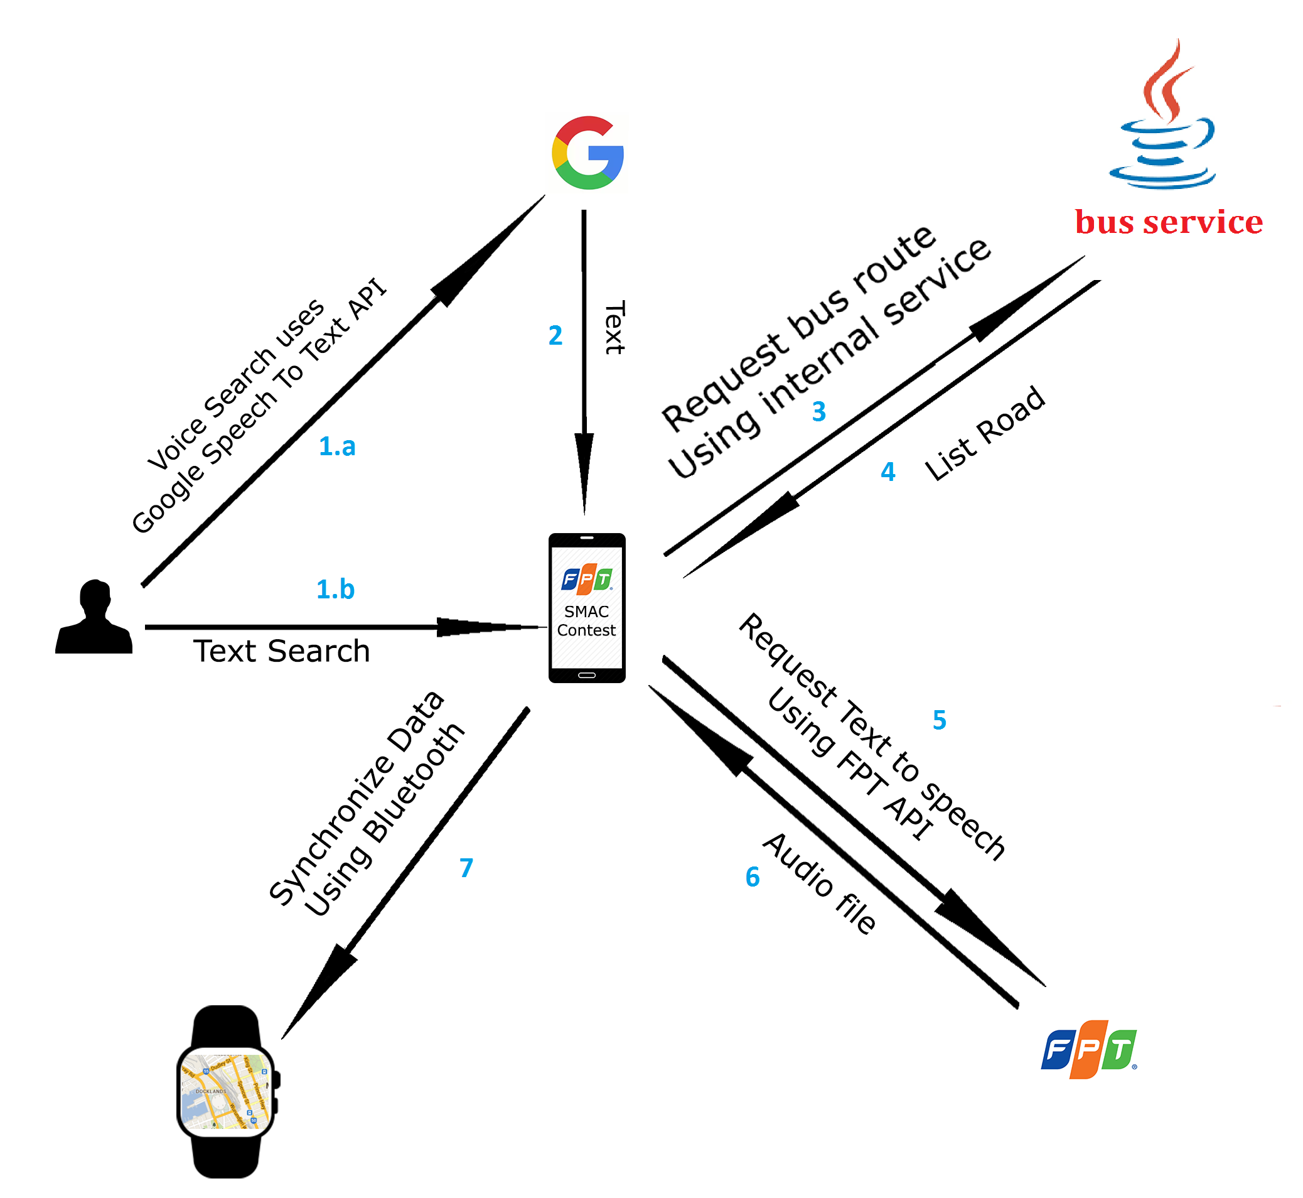
Architecture: Bus Routing

Slide 105
Best Result
55
33
104, 53

Slide 106
Best Result
55
33
104, 53

Slide 107
Prepare Data
Result
1
0..*
<<Interface>>
INode
code
totalDistance
totalTime
minutes
totalTransfer
Segment
Path
routeId
routeName
routeNo
transferNo
pathType
segmentDistance
segmentTime
stationFrom
stationTo
transferTurn
pathType
distance
time
points
0..1
1..*

Slide 108
Best Result
55
33
104, 53

Slide 109
Best Result
55
33
104, 53

Slide 110
Best Result
55
33
104, 53

Slide 111
Prepare Data
Result
1
0..*
Journey
code
totalDistance
totalTime
minutes
totalTransfer
code
totalTime
totalDistance
minutes

Slide 112
Search Motorbike Route
Search Route
Search Motorbike Route

Slide 113





Bus Scenario

Slide 114
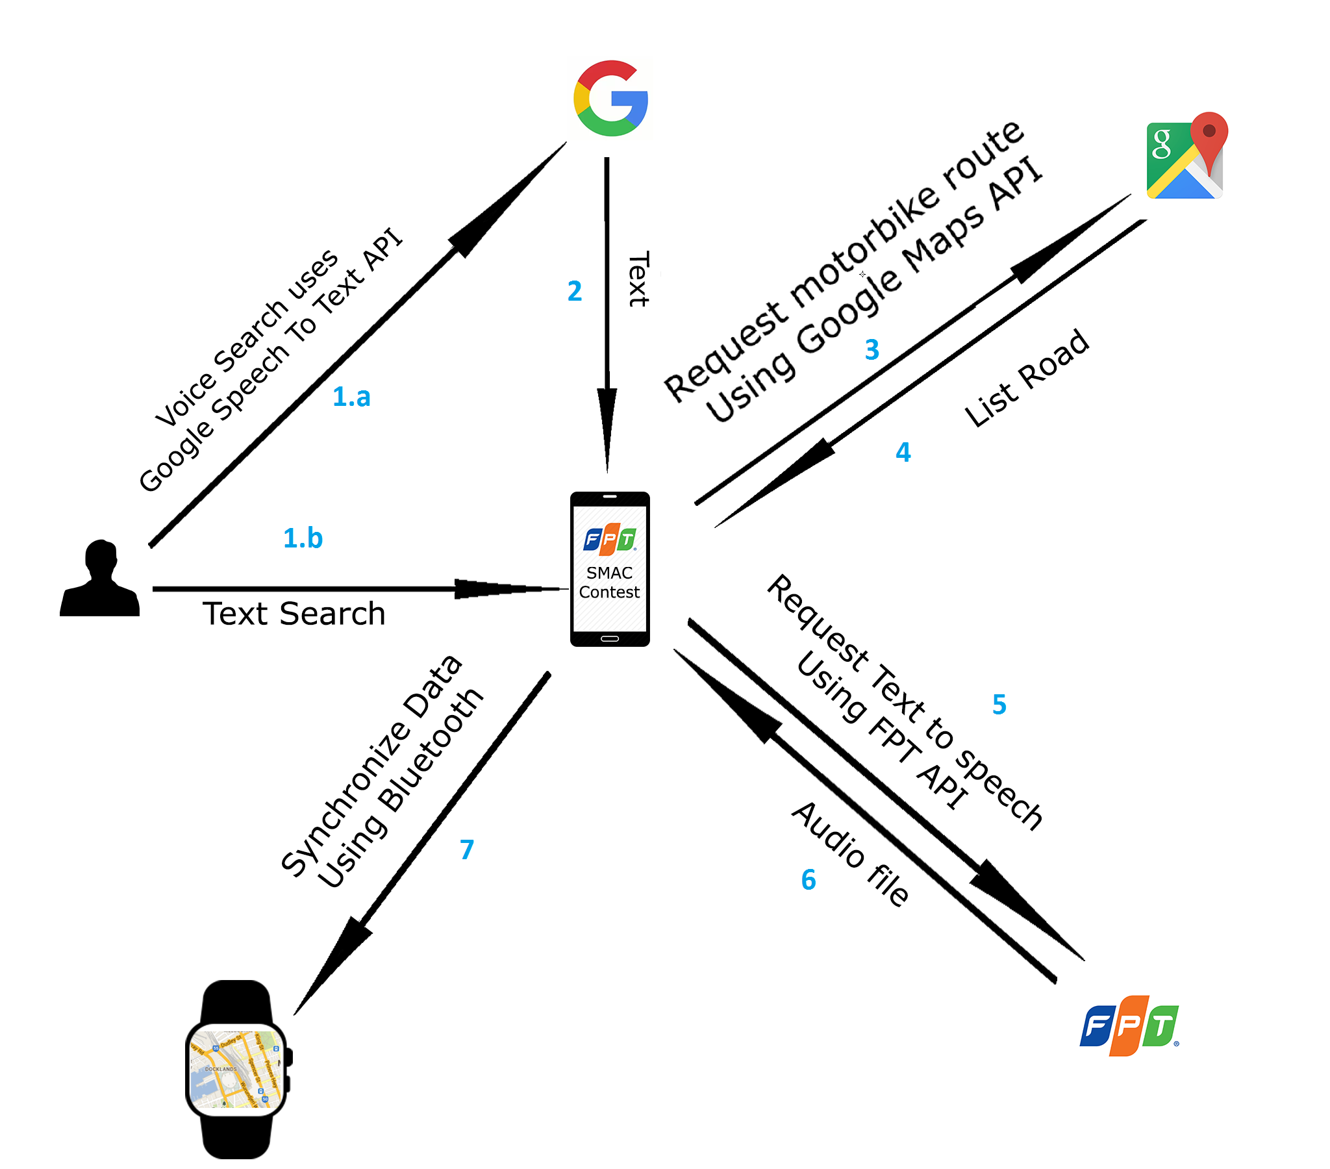
Architecture: Motorbike Routing

Slide 115
Best Result
1
2
3

Slide 116
Prepare Data
Leg
1
0..*
Step
startAddress
endAddress
Steps
…
instruction
maneuver
….

Slide 117
Notify System Algorithm

Slide 118
Distance From One Point to Segment Algorithm

Slide 119
A
B

Slide 120
A
B

Slide 121
C
A
B

Slide 122
C
d
A
B

Slide 123
A
B
C

Slide 124
A
B
C

Slide 125
A
B
C

Slide 126
A
B
d
C

Slide 127
Notify System algorithm

Slide 128
E
A
C
D
B

Slide 129
E
A
C
D
B

Slide 130
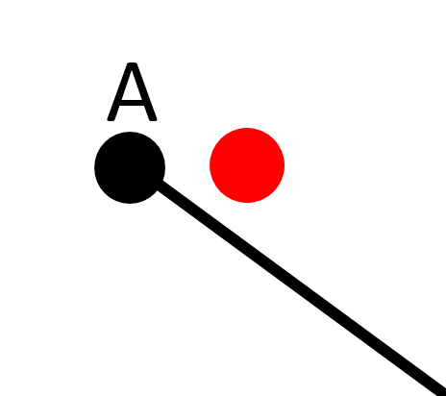
E
A
C
D
B

Slide 131
E
A
C
D
B

Slide 132
E
A
C
D
B

Slide 133
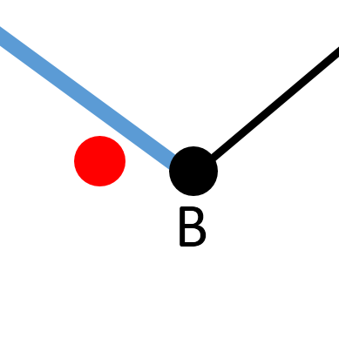
E
A
C
D
B

Slide 134
Notify: prepare to turn left
E
A
C
D
B

Slide 135
E
A
C
D
B

Slide 136
Notify: prepare to turn right
E
A
C
D
B

Slide 137
E
A
C
D
B

Slide 138
Notify: wrong way
E
A
C
D
B

Slide 139
E
A
C
D
B

Slide 140
E
50
A
C
D
B

Slide 141
E
50
A
C
45
D
B

Slide 142
E
50
20
A
C
45
D
B

Slide 143
E
50
20
A
C
15
45
D
B

Slide 144
E
50
13
A
C
20
15
45
D
B

Slide 145
E
A
C
D

Slide 146
E
A
C
D

Slide 147
E
E
A
C
D
Red Point is on the left of blue vector
D

Slide 148
Notify: navigate to left
E
A
C
D

Slide 149
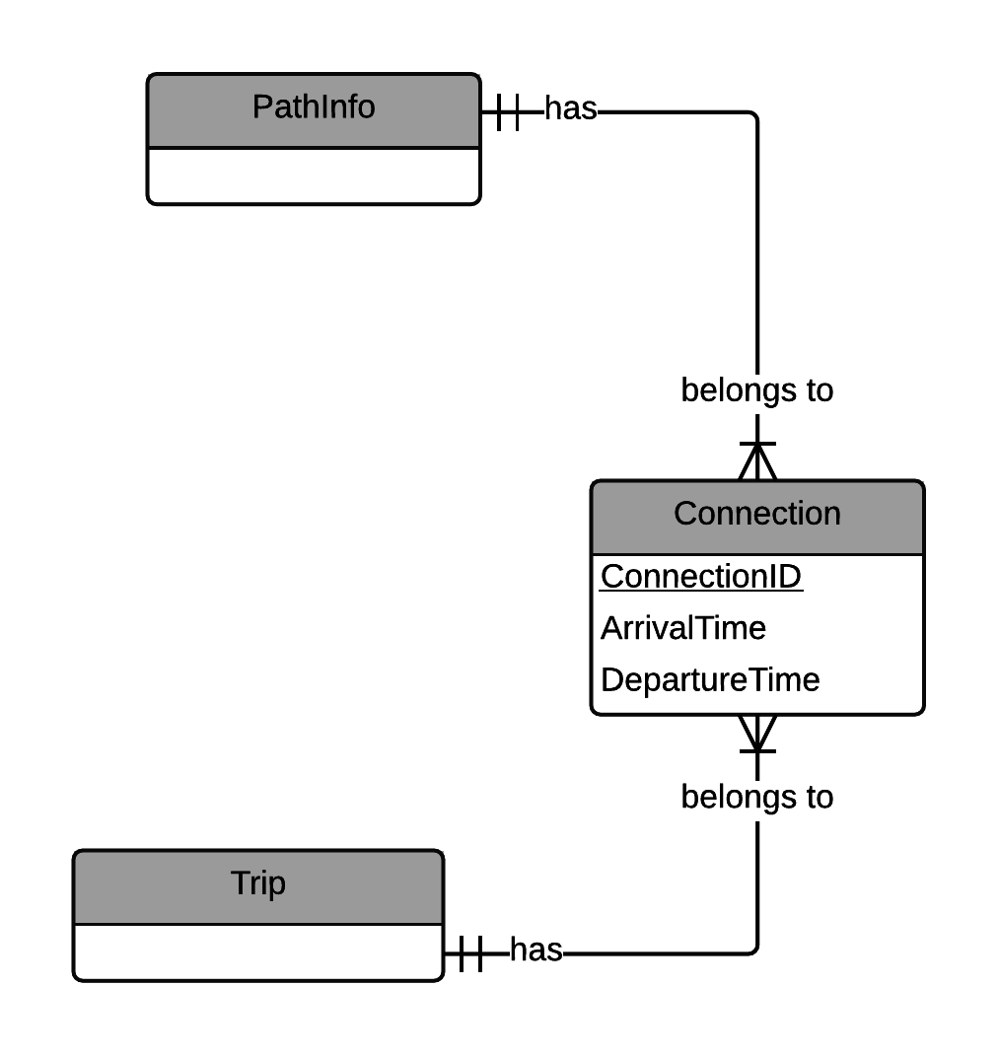
Future plans
1
Support collecting data from bus driver
Notes:
Đây là thiết kế mà chúng tôi đề xuất dành cho mô hình Nhiều công ty đa dịch vụ.
Tại máy chủ trung tâm, chúng tôi cài đặt thành phần dùng chung để quản lý các thông tin chung của nhiều công ty.
Sau đó, tại mỗi công ty chúng tôi sẽ cài đặt lên module các thành phần liên quan đến nghiệp vụ riêng biệt của từng công ty.
Ở mô hình này chúng tôi chỉ đưa ra góc nhìn tổng quát về thiết kế của hệ thống, để triển khai thật sự thì cần phải giải quyết rất nhiều bài toán phát sinh.

Slide 150

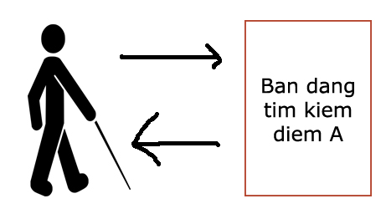
Future plans
1
2
Supporting blind people fully use application.

Slide 151
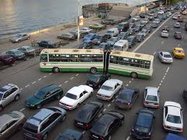
Future plans
1
2
3
Traffic jam notification system service

Slide 152
Overview
Problems
Solution
Feature explanation and demo
Search motorbike four points
Tracking motorbike’s route and notify
View notification on wear
Detect wrong route and recommend another route.
Search bus four points by using voice
Future plan
Notes:
Nhóm chúng tôi xin trình bày các nội dung sau:
Thứ nhất là vấn đề hiện tại của bảo hiểm xe máy
Thứ hai là giải pháp nhóm chúng tôi đưa ra
Tiếp đến là phần giải thích các chức năng và demo
Và cuối cùng là kế hoạch phát triển trong tương lai.
Sau đây anh Nguyễn Hữu Phúc sẽ trình bày về các vấn đề hiện tại của bảo hiểm xe máy

Slide 153
THANKS FOR LISTENING
Q/A

